Slide 1
Purchase Card
Notes:
Introduction
Who you are
The Class
What will we do in the class

Slide 2
Purchase Card Guidance and Use
In accordance with CFO 4200.1A,
d. Cardholders.
(5) Obtain prior written authorization from the authorizing official for all purchases;
(7) Ensure the independent receipt and acceptance of goods and services is documented for all purchases over $75;
(8) Obtain written verification of receipt for all supplies or services not delivered and accepted directly by the cardholder
For more information visit:
http://insite.gsa.gov/wps/portal/gsa_insite/purchasing_and_payments/gsa_purchase_card/
Notes:
Your requisition to purchase goods and services
Capture the approvals – Once request is approved you say what you want to purchase
PR goes to contracting officer
PR tells what you want to order and the funding

Slide 3
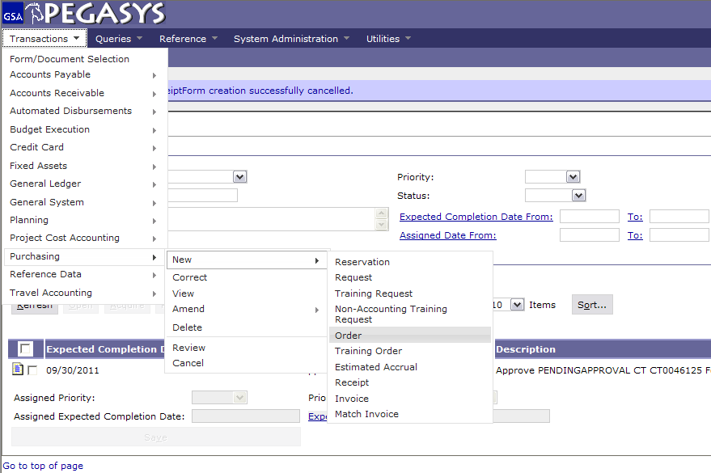
Create a Purchase Card Log
Select :
  - Transactions
  - Purchasing
  - New
  - Order
Notes:
PR is “Copied Forward” to the GP
Once it is an Order, it is an Obligation. (Undelivered Order)
Once Order-Invoice-Receipt match Pegasys Pays the Vendor- money is no longer GSA’s
If you do not like it or do not want it, do not do a Receipt. Otherwise, Pegasys will pay it

Slide 4
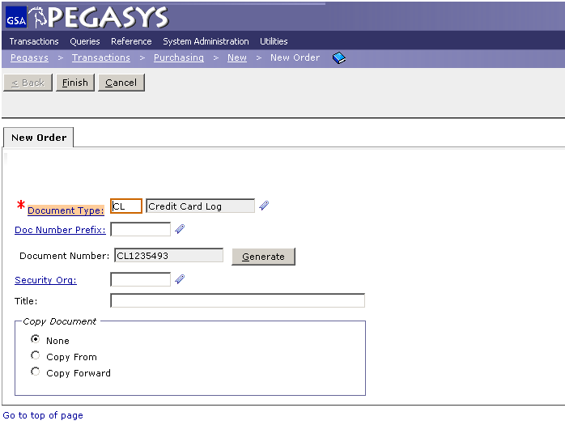
Purchase Card
Enter CL
- Press Tab
- Click Generate
- Click Finish
Use the CL Document Number on all documents
Notes:
Training Request= TR
Not used very often, usually only for Prepaid Training

Slide 5
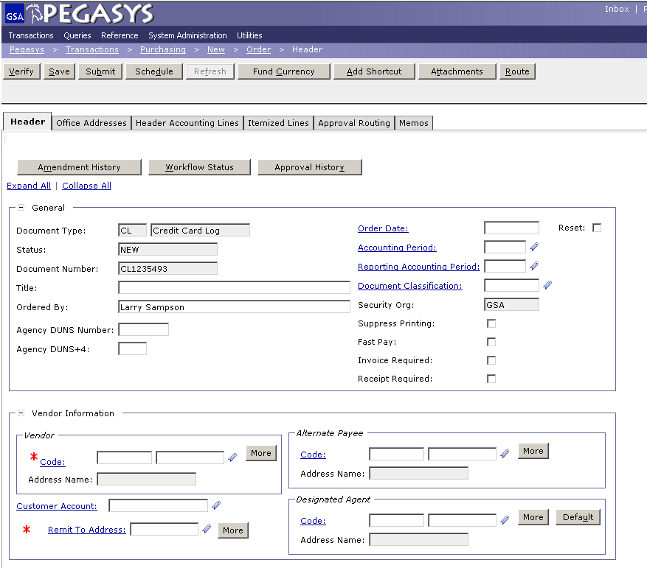
Header Tab
Enter :
- Title
Ordered by
Click :
Code (in the Vendor box)
Notes:
PR is universal across all GSA offices
Document number is composed of the Date and the last four numbers are a sequence

Slide 6
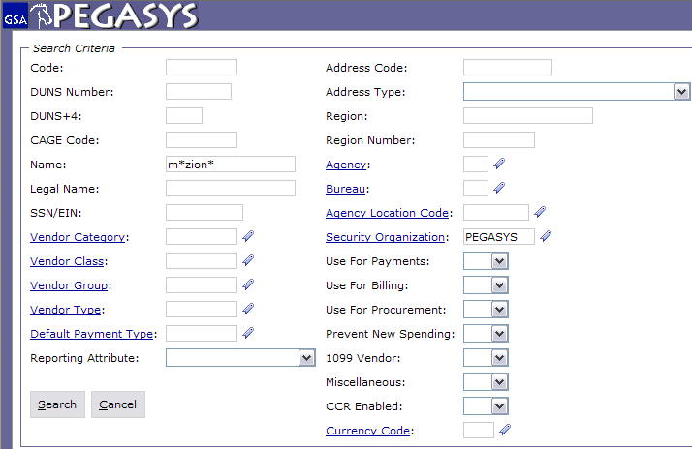
Vendor Code Search
Save Often
Enter :
Code – Tax Identification Number (TIN)
or DUNS
or Name
*Intelligent*
Enter :
Pegasys (in Security Org)
The * is a wild card for searching
Notes:
Code is the TIN # (tax identification number)
Use wild card because Pegasys looks for an exact match Example: Inc does not equal Inc.
If the vendor isn’t in Pegasys then you can email the finance centers in FW and KC to get the vendor put in. Takes less then 24hrs

Slide 7
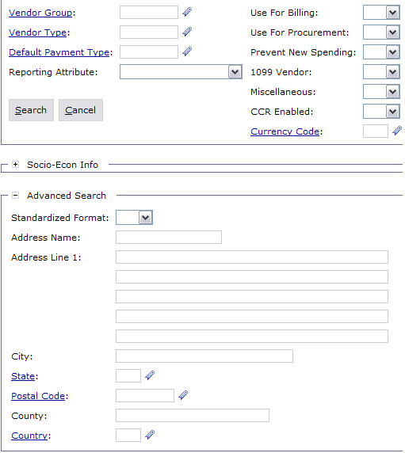
Vendor Advanced Search
To assist in narrowing down the search
Enter :
City and/or State
Click :
- Search
Notes:
Description is displayed on the Transaction Summary Report

Slide 8
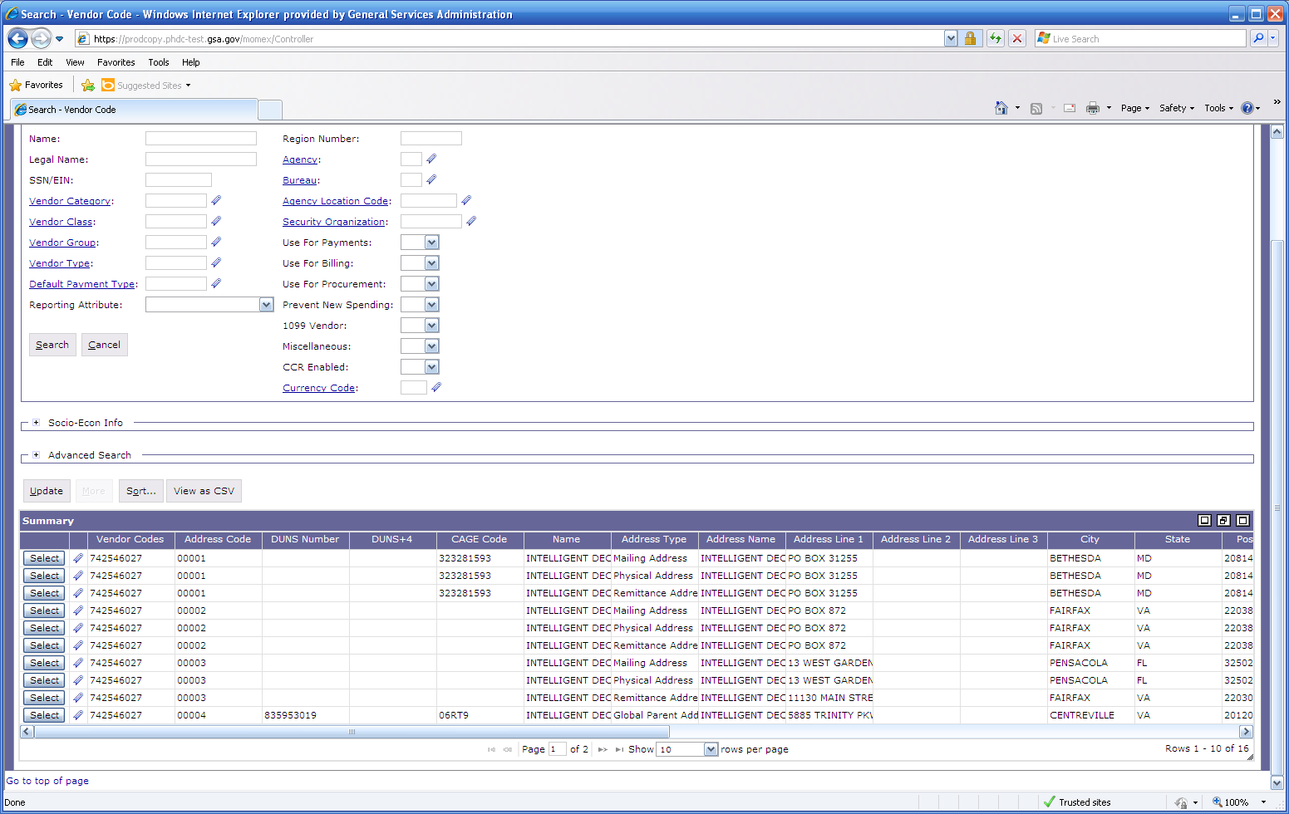

Vendor Results
Click on Favorites icon to save Vendor Address Code
- Click Select
to populate field
https://finance3.gsa.gov/

Slide 9
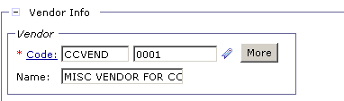
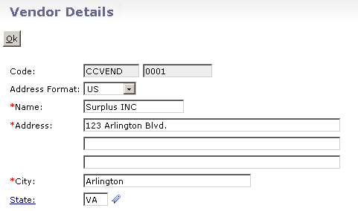
CCVEND
If you cannot find a vendor
Enter :
- CCVEND (into Code field)
Click :
- More
Do NOT use CCVEND for
convenience checks, only use with Purchase Cards.
Enter in address information
Click :
- Ok
https://finance3.gsa.gov/
Notes:
Pegasys sends an email to solicit for a receipt, so put the receiver of the goods in the *Email field

Slide 10
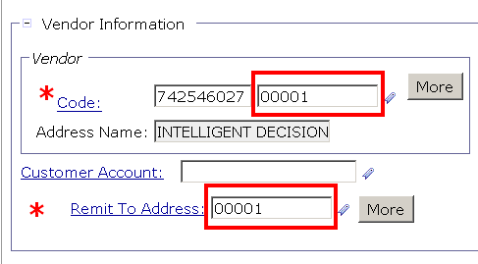

Remit To Address
Enter :
- Remit To Address
The favorites icon can be used to populate this information as well.

Slide 11
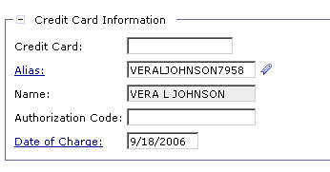
Purchase Card Information
Enter :
Alias (This can be made a favorite.)
Date of Charge (Click hyperlink for calendar)
- Authorization Code (6 digits and optional)
Notes:
This is OPTIONAL but you can add the contracting vendor by Suggested Vendor

Slide 12
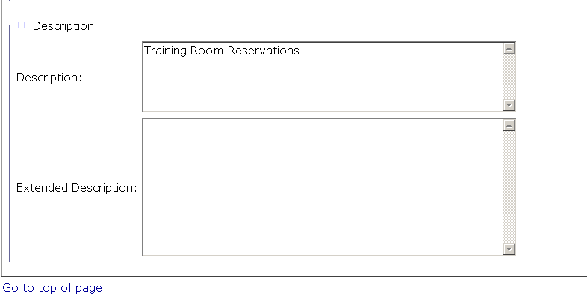
Description
Enter :
- Description
Notes:
Code is the TIN # (tax identification number)
Use wild card because Pegasys looks for an exact match Example: Inc does not equal Inc.
If the vendor isn’t in Pegasys then you can email the finance centers in FW and KC to get the vendor put in. Takes less then 24hrs

Slide 13
Sample Accounting Templates
Accounting Template
2012
G
00
BD
262X
CST1
S00B0410
GM&A
FY
Service
Region
Corr. Symbol
Fund
Program
Org. Code
2012
P
00
192
P0010001
PG61
PBS
FY
Service
Region
Fund
Org. Code
Program
2012
A
00
285X
AF00
A0010100
AF372
_AdTravel
FAS
FY
Service
Region
Fund
Program
Org. Code
Activity

Slide 14
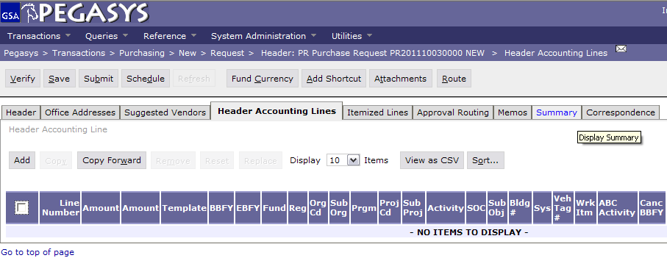
Header Accounting Lines
Save Often
Click :
- Header Accounting Lines
- Add

Slide 15
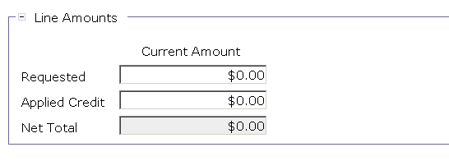
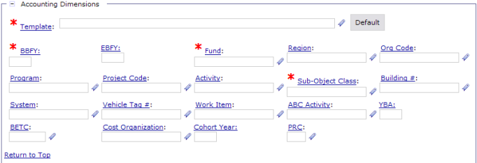

Header Accounting Line Tab
Enter :
- Line Amounts
Click :
Template
or
Click :
Favorites Icon
and
Click :
- Default

Slide 16
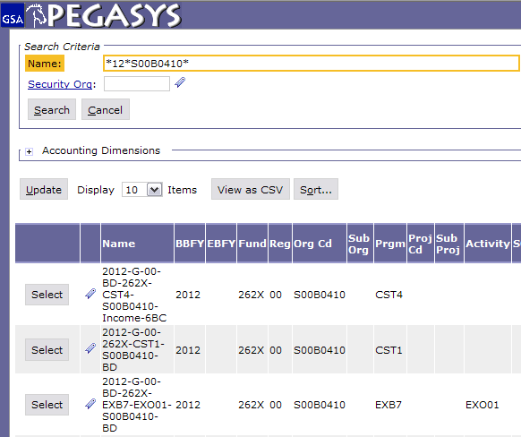
Header Accounting Line Tab (2)
- Type in the known information
- Click Search
- Add to the Favorites and select the correct string
The * is a wild card for searching
  For information on how to use favorites , go to http://pegasys.gsa.gov/ref/howto.htm

Slide 17
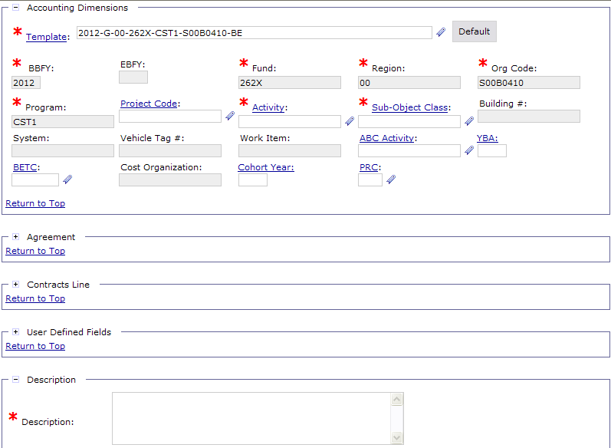
Header Accounting Line Tab (3)
Enter :
Activity
SOC
Note: Your accounting classification may require other data elements to be entered, such as BLDG Number, Work Item, Vehicle Tag #, Project Code, etc.

Slide 18
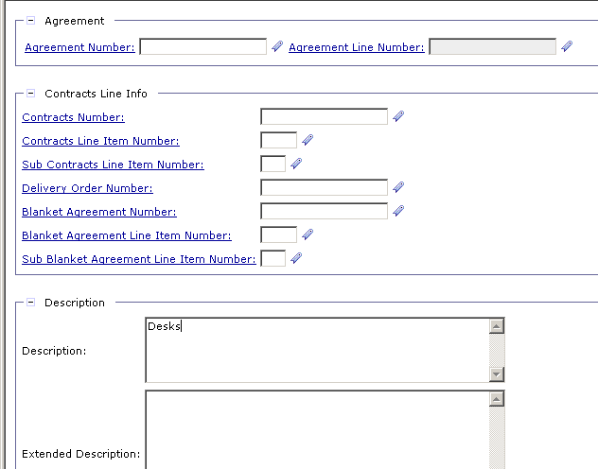
Header Accounting Line Tab (4)
PG80 ONLY
When entering RWA’s, use the Agreement Number Field.
Enter :
- Numbers only
- 1 (in the Agreement Line Number)
RWA - Reimbursable Work Authorization
Notes:
Agreement Number is the RWA number (PBS ONLY)
Drop alpha and add the number
If you have more than one accounting lines use the Description field to distinguish between them.

Slide 19
Description
Enter :
- Description
Notes:
Description is displayed on the Transaction Summary Report

Slide 20
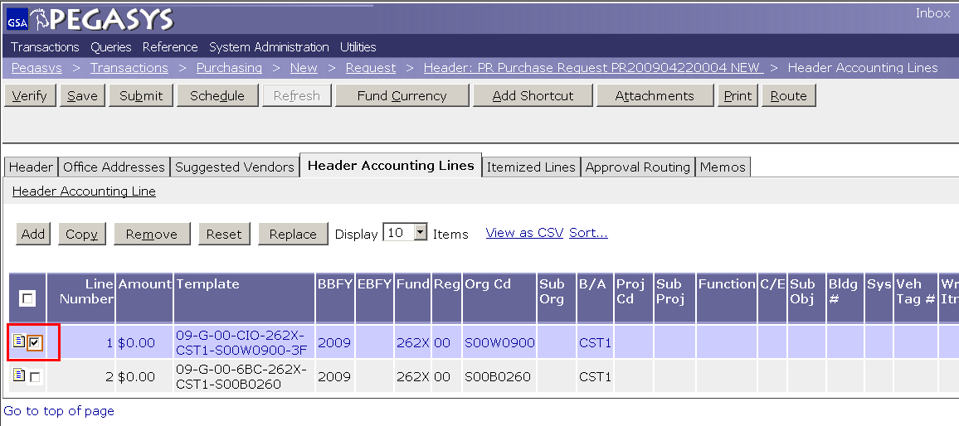
Multiple Lines
Save Often
Click :
- Add (then refer back to page 15)
or
Highlight
- Line
Click :
Copy
Header Accounting Line (hyperlink to make changes)
Notes:
DEMO:
Using the new Form from the previous example, on the Header Accounting Lines tab
Click the Add button to add a line
Click the Favorites icon for the Template field
Click the Search Link
Enter CC-192X-PG61-P032C300* in the Code Field
Click the Search button
Click Favorites icon to add to Favorites
Click the Cancel button
Back on the Form, display the newly created Favorite by clicking the Favorite icon for the Template field

Slide 21
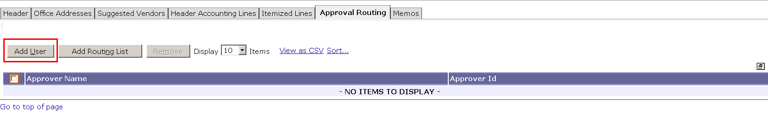
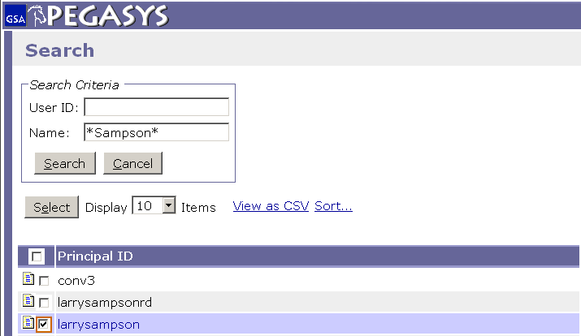
Approval Routing (Add User)
Approval Type
  Credit Card
- Click Approval Routing
- Click Add User
- Enter Approver Name
- Click Search
Highlight Line
- Click Select
The * is a wild card for searching
Notes:
If the approver has a backup Pegasys will send to both. If one approves it, it will show up to the other as Acquired and won’t be accessible.

Slide 22
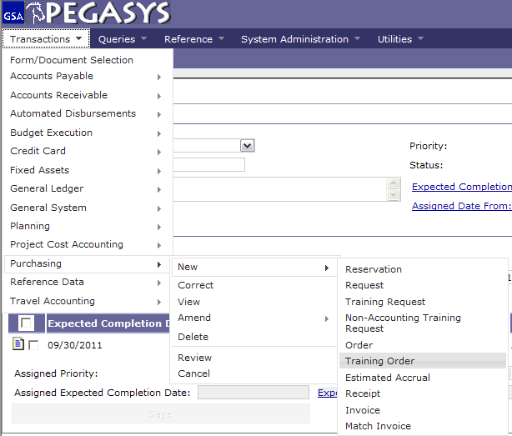
Creating a Purchase Card Training Log
Select :
Transactions
Purchasing
New
Training Order
Notes:
DEMO:
Using the new Form from the previous example, on the Header Accounting Lines tab
Click the Add button to add a line
Click the Favorites icon for the Template field
Click the Search Link
Enter CC-192X-PG61-P032C300* in the Code Field
Click the Search button
Click Favorites icon to add to Favorites
Click the Cancel button
Back on the Form, display the newly created Favorite by clicking the Favorite icon for the Template field

Slide 23
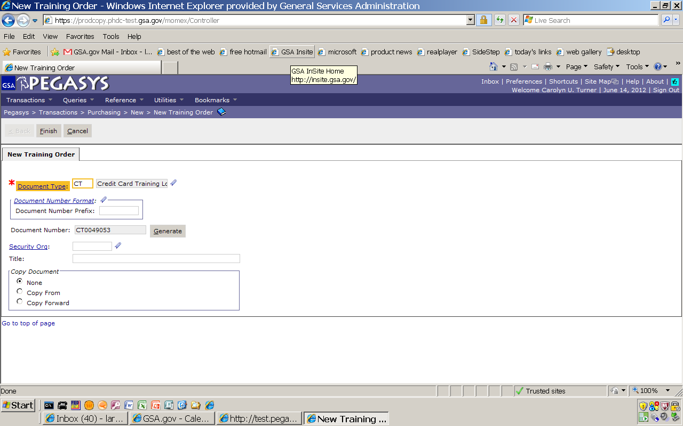
Creating a Purchase Card Training Log (2)
Enter CT
- Press Tab
- Click Generate
- Click Finish
Use the CT Document Number on all documents
Notes:
If the approver has a backup Pegasys will send to both. If one approves it, it will show up to the other as Acquired and won’t be accessible.

Slide 24
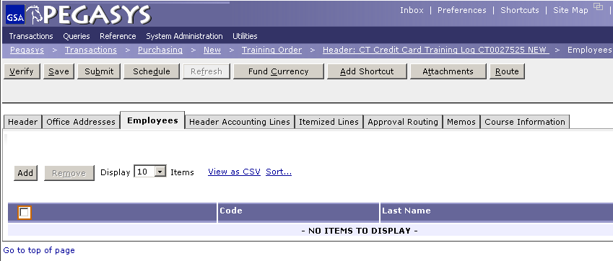
Employees Tab
Save Often
Click :
- Employees
- Add

Slide 25
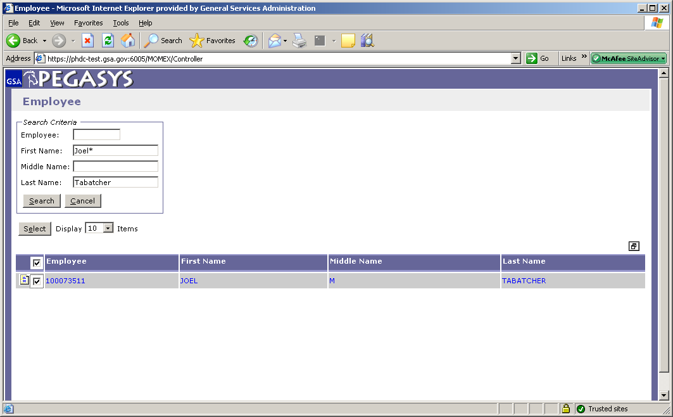
Employees Search
Enter :
- Name of Employee (in name fields)
Click :
- Search
Highlight Employee
Click :
- Select
The * is a wild card for searching
If an employee is not in the system, contact the OCFOServiceDesk@gsa.gov
Notes:
Receipt based on goods that are physically here, or through email
Can do Receipt before Pegasys prompts you. If you get the goods and they are good then do the receipt!

Slide 26
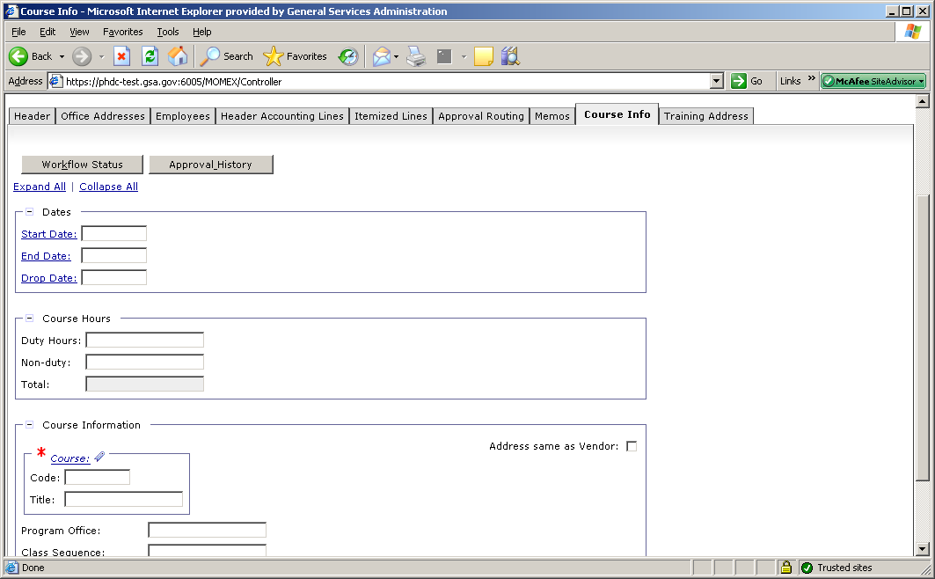
Course Information
Save Often
Click :
Course Info
Enter :
Course Code
Title
For more information, go to http://pegasys.gsa.gov/ref/howto.htm

Slide 27
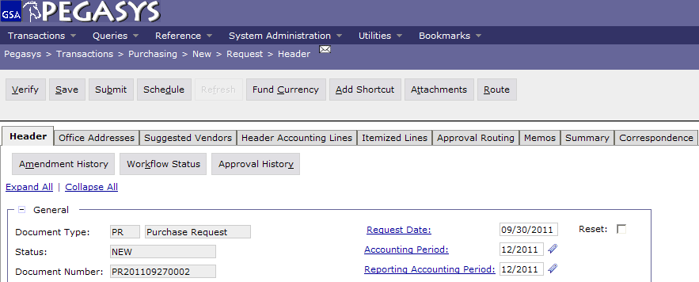
Save, Verify, Submit
  To finish the Form:
  - Save the form
  - Verify and correct any errors
  - Submit the document for approvals and processing

Slide 28
Convenience Checks
Convenience checks require:
CL/CT for actual transaction
  Must equal amount of check
  Vendor Code – Merchant
Check Fees
  Reconcile to an Accounting Strip
  Vendor/Address = 460358360/00021(Citibank)
  SOC = J01
  Accounting Template & Activity same as used in CL/CT or special accounting template designated by your office or region.

Slide 29
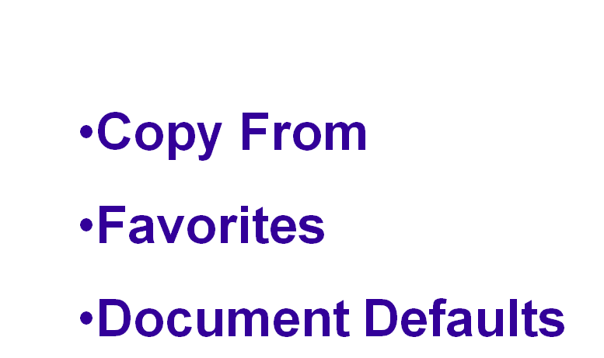

Features

Slide 30
Reconciliation
Notes:
Introduction
Who you are
The Class
What will we do in the class

Slide 31
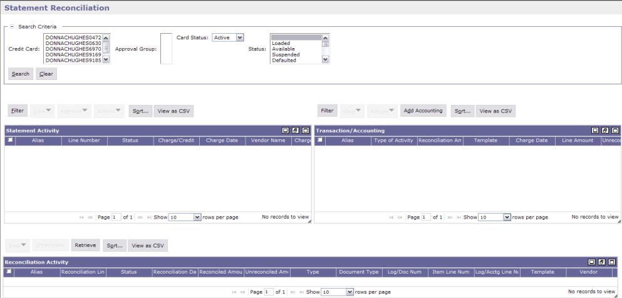
Reconciliation Notebook Overview
Search Criteria
Status
Charges & Credits from Citibank
Logs
Accounting Strip
Reconciliation
Unreconcile
History
Notes:
PR is universal across all GSA offices
Document number is composed of the Date and the last four numbers are a sequence

Slide 32
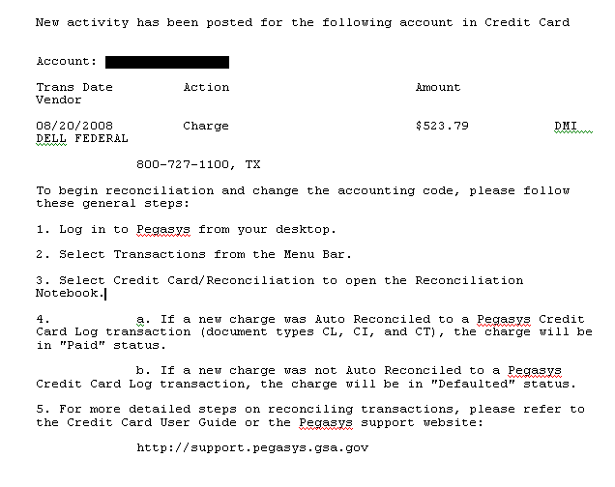
Email Notification
Notes:
Your requisition to purchase goods and services
Capture the approvals – Once request is approved you say what you want to purchase
PR goes to contracting officer
PR tells what you want to order and the funding

Slide 33
Statement Reconciliation
Automated Reconciliation
Attempts to automatically match information on the bank statement with purchase card log documents based on the following criteria:
  Purchase card number
  Authorization code (optional)
  Charge amount (exact match)
  Charge date within tolerance limit (5 days)
Notes:
PR is “Copied Forward” to the GP
Once it is an Order, it is an Obligation. (Undelivered Order)
Once Order-Invoice-Receipt match Pegasys Pays the Vendor- money is no longer GSA’s
If you do not like it or do not want it, do not do a Receipt. Otherwise, Pegasys will pay it

Slide 34
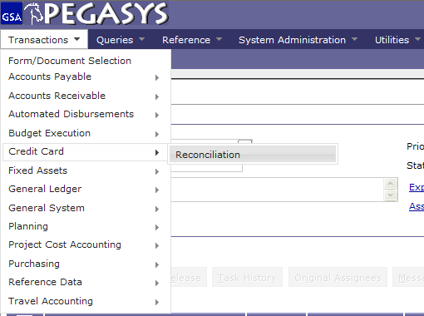
Reconciliation
Select:
- Transactions
- Credit Card
- Reconciliation
Notes:
Training Request= TR
Not used very often, usually only for Prepaid Training

Slide 35
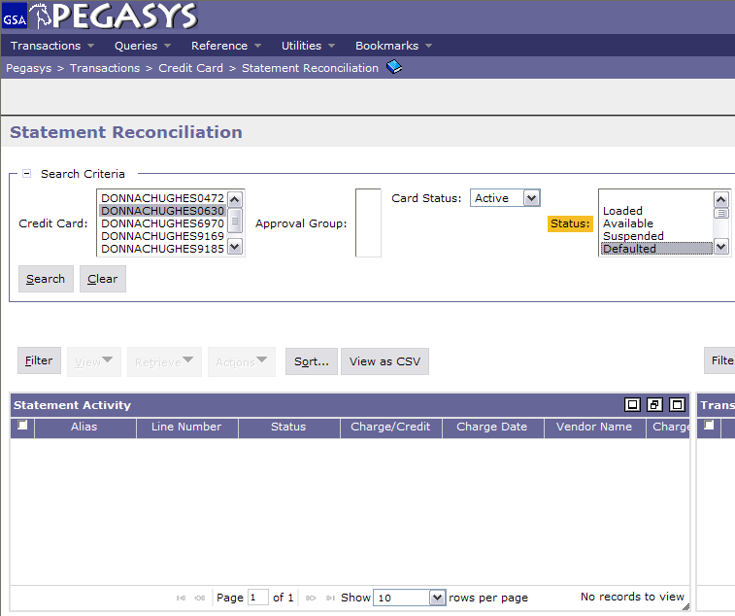
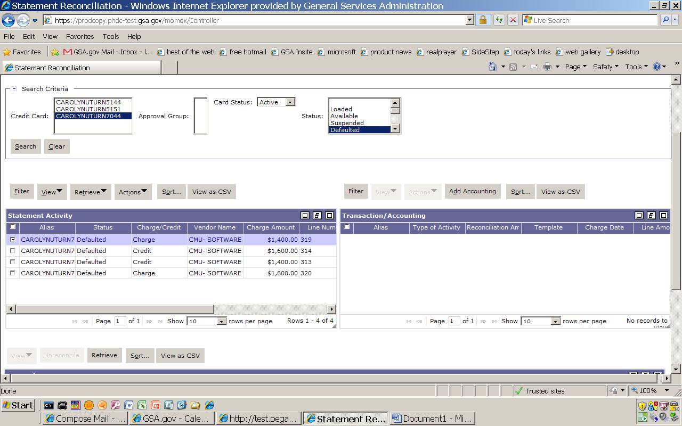
Reconcile Statement/Credit Card Log
Highlight :
Alias (Credit Card)
- Defaulted (Status)
Click:
Search
Notes:
Does not need a vendor (contracting officer researches to find best price)
Title is optional but highly recommended. If you search all of your PR’s whatever you write in Title will be displayed.
Requested by is who wants it, if you’re ordering for the whole office you want to know who it is going to.

Slide 36
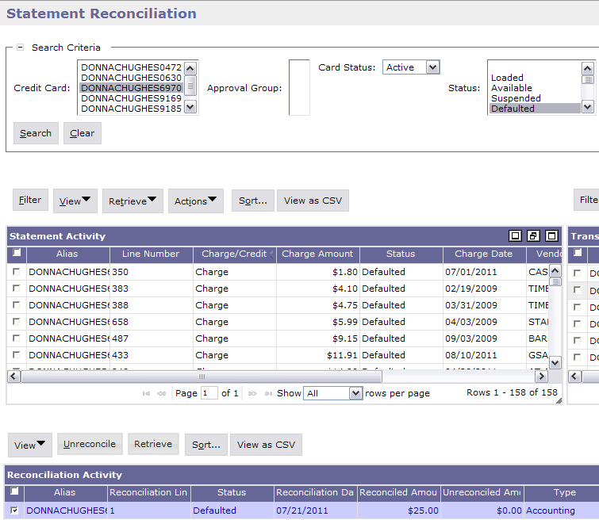
Statement Activity
Highlight :
Statement line (from the Statement Activity section in Defaulted status)
Click:
Retrieve (in the Reconciliation Activity section)
Columns can be rearrange to see the information needed

Slide 37
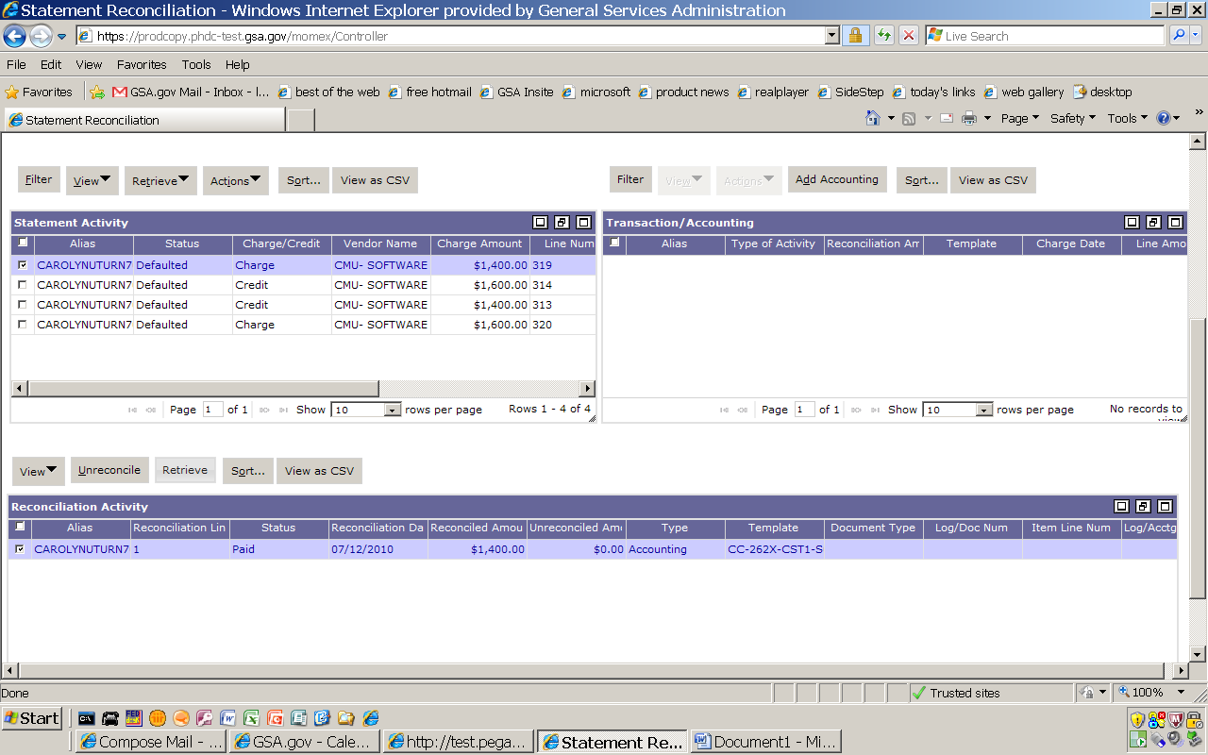
Un-reconcile a Default Charge
Highlight :
- The charge line (In the Reconciliation Activity section)
  Click :
  - Unreconcile

Slide 38
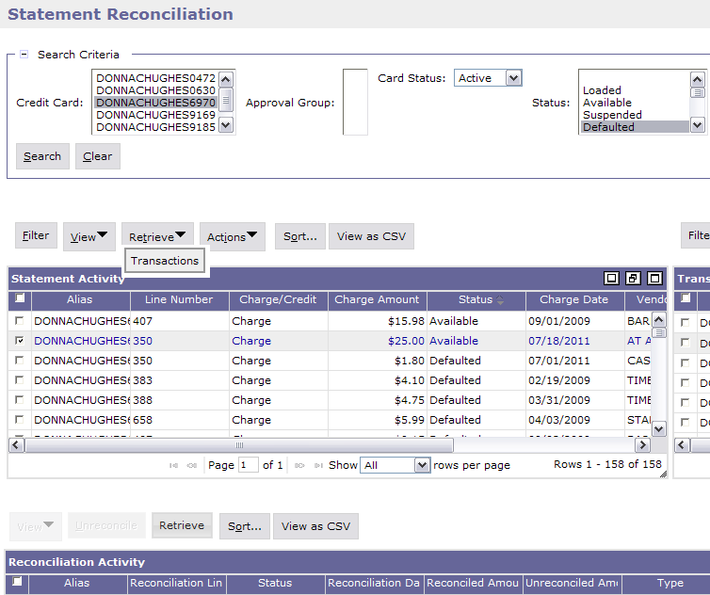
Reconcile Statement/Credit Card Log
Highlight :
Statement line (from the Statement Activity section in Available status)
Click :
Retrieve
Transactions

Slide 39
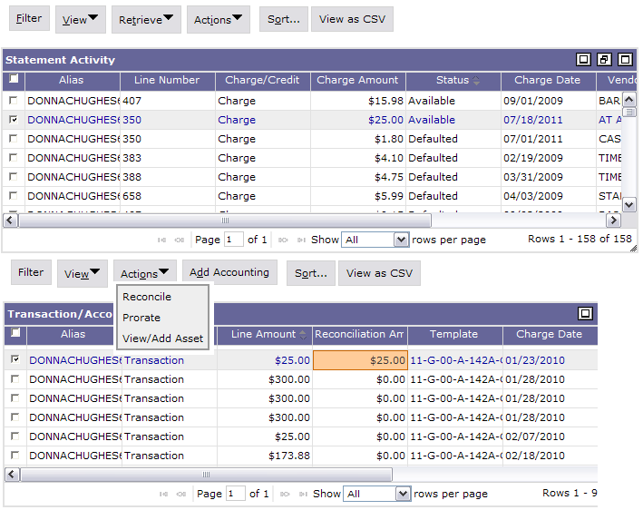
Transaction/Accounting
Highlight :
- Transactions Line (in the Transaction/Accounting section)
Enter :
Reconciliation amount
Click :
Action
- Reconcile

Slide 40
Reconcile to an Account Strip
Highlight :
- Alias (Credit Card)
- Defaulted (Status)
Click:
Search
Notes:
Does not need a vendor (contracting officer researches to find best price)
Title is optional but highly recommended. If you search all of your PR’s whatever you write in Title will be displayed.
Requested by is who wants it, if you’re ordering for the whole office you want to know who it is going to.

Slide 41
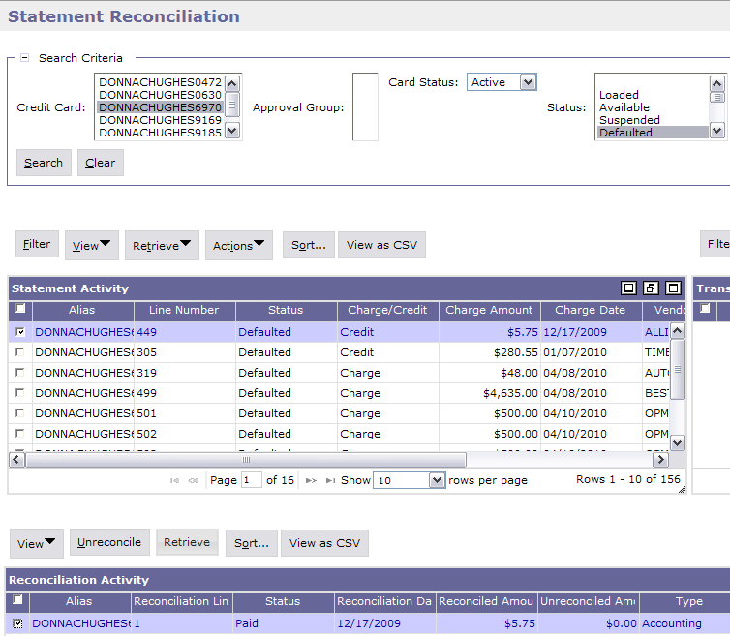
Reconciliation to a Account Strip - Statement Activity
Highlight :
Statement line (from the Statement Activity section in Defaulted status)
Click :
Retrieve (in the Reconciliation Activity section)
Columns can be rearrange to see the information needed

Slide 42
Reconciliation of an Account Strip - Un-reconcile a Default Charge
Highlight :
- The charge line (In the Reconciliation Activity section)
  Click :
  - Unreconcile

Slide 43
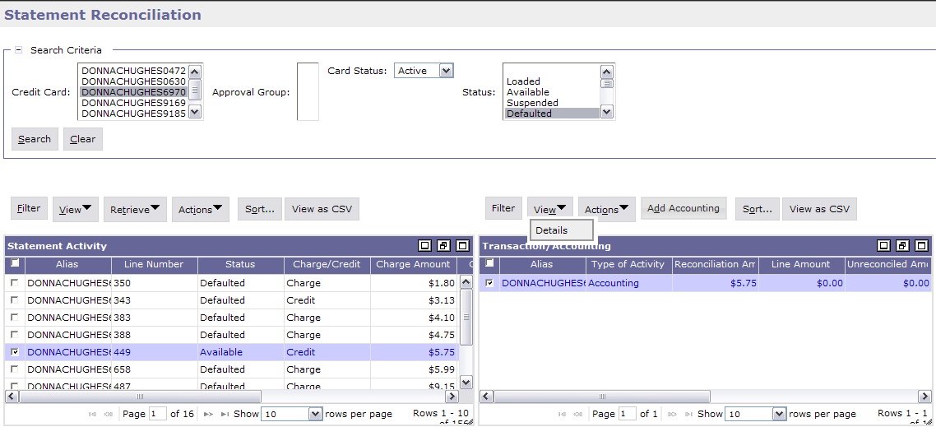
Reconcile to an Account Strip – Add Accounting
Click :
– Add Accounting (in the Transaction/ Accounting section)

Slide 44
Sample Accounting Templates
Accounting Template
2012
G
00
BD
262X
CST1
S00B0410
GM&A
FY
Service
Region
Corr. Symbol
Fund
Program
Org. Code
2012
P
00
192
P0010001
PG61
PBS
FY
Service
Region
Fund
Org. Code
Program
2012
A
00
285X
AF00
A0010100
AF372
_AdTravel
FAS
FY
Service
Region
Fund
Program
Org. Code
Activity

Slide 45
View Details
Click:
View
Details

Slide 46
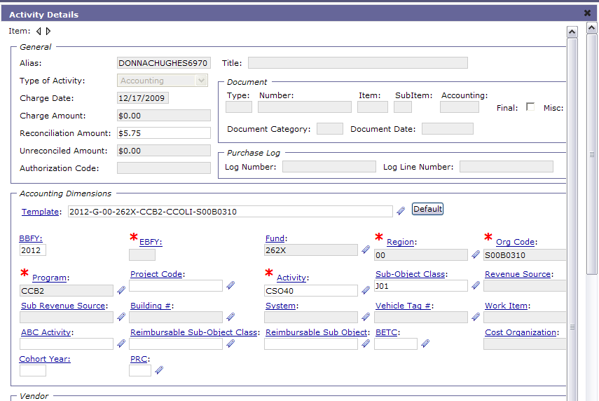
Enter Template
Click :
Template
or
Click :
Favorites Icon
and
Click :
- Default

Slide 47
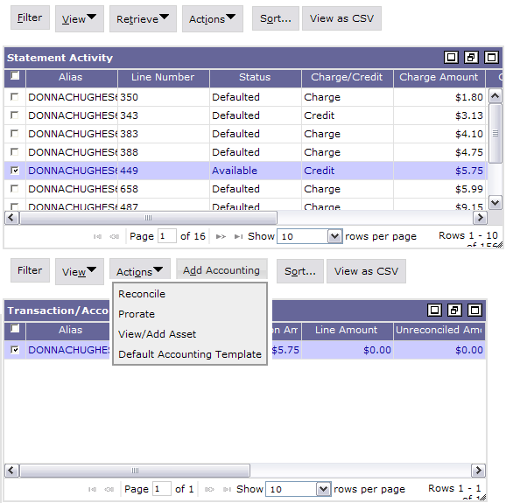
Reconciliation
Make sure the credit line and the accounting strip line are both highlighted.
Click :
Actions
Reconcile

Slide 48
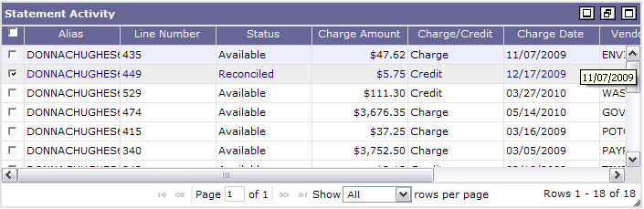
Reconcile to an Account Strip – Reconciliation (Cont.)
The Statement line status is now reconciled.

Slide 49
Search Feature
Click :
Filter

Slide 50
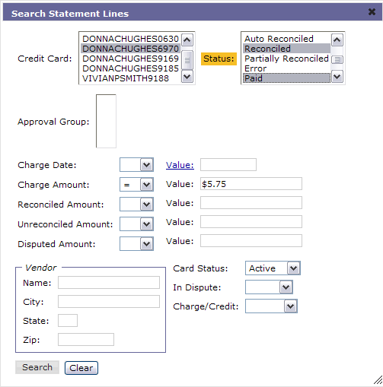
Search Feature
Highlight :
- Alias (Credit Card)
- Desired Status
Ex: Reconciled and Paid
Enter :
Charge Amount Ex: =
Value Ex: $5.75
Click :
- Search

Slide 51
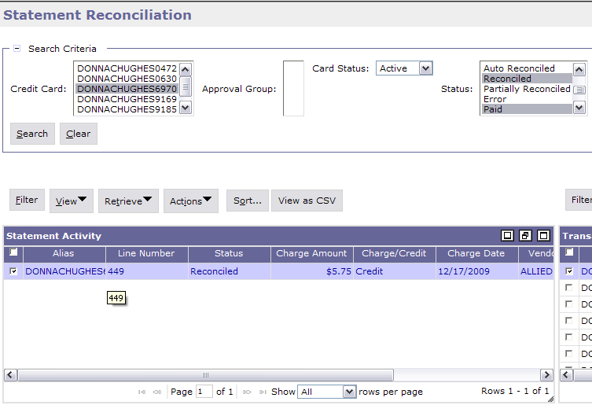
Search Feature
The document with the searched criteria will appear.

Slide 52
Additional Assistance
Pegasys Web Site - http://pegasys.gsa.gov
  User Guides
  Quick Reference Cards
  Pegasys Training Classes
OCFO Consolidated Service Desk
  1-866-450-6588
  ocfoservicedesk@gsa.gov
ocfocustomerservice.gsa.gov
Notes:
If 90% of the time when you do a credit card it is same funding then set up the accounting string as a default.

Slide 53

Goals of Information Security
Confidentiality
  Data must be protected against unauthorized disclosure
Integrity
  Systems must not permit processes or data to be changed without authorization
Availability
  Systems must be functional and operational
Confidentiality
Availability
Integrity
Notes:
Please take a few moments and review the remaining slides on Information Security

Slide 54
Why is Information Security Important?
Must be in compliance with regulatory requirements such as OMB Circular A-130, Computer Security Act, FISMA and GSA IT security policies
Protects GSA information resources from potential abuse and misuse
Follows sound business practices

Slide 55
User Responsibility
Responsible for adherence to GSA information security policy
Protect Pegasys login ID and password
  Do not allow others to use your login ID / password
  Do not write it down
Log out whenever you are not using Pegasys
Protect sensitive information
  Shred reports containing sensitive information
Report security incidents
  Refer to OCFO Incident Handling Procedures for further guidance
  Report security incidents to your supervisor

Slide 56

Keys to Incident Prevention
Awareness - be aware of the value of the assets you are using to do your job and the nature of associated threats vulnerabilities and suspicious activities
Compliance - comply with established safeguards, policies, and processes
Common Sense - if something appears to be off, it generally is

Slide 57

Remember ...
Security is a PEOPLE issue,
not only a TECHNICAL one!

